Slide 1
Web programming ii
Software engineering / ecommerce & digital marketing

Slide 2
Plan of the Day
Overview of previous knowledge
Internet VS World Wide Web
Internet, Intranet and Extranet
Implementation of an intranet
Presentation of development tools
Collaborative working
Presentation of group works

Slide 3
Overview of previous knowledge
Correction of assignment
User research and testing reports
Wireframe diagrams
Site diagram

Slide 4
User research and testing reports
Understanding the needs, desires, and limitations of users is central to the success of the design of the site or web application.
User Centered Design (UCD)
Site designs is often conducted with user research, including interviews and observations,.
It is aimed at gaining a better understanding of how the site can solve problems or how it will be used.

Slide 5
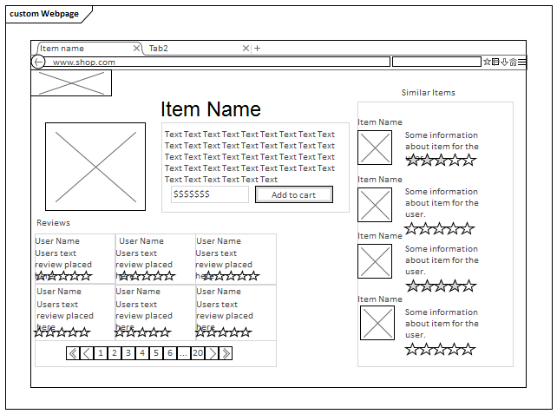
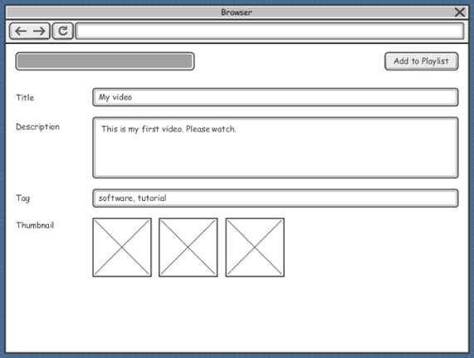
Wireframe diagrams

Slide 6
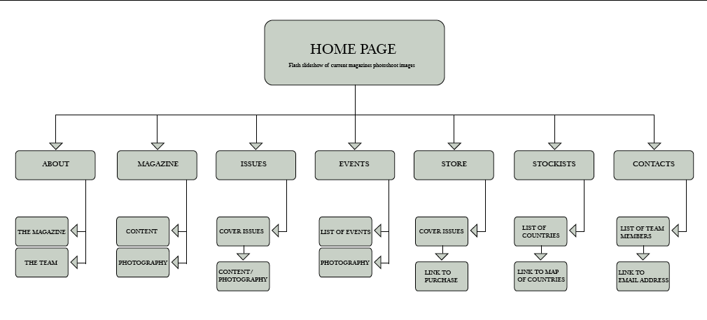
Site diagram

Slide 7
What Languages Do I Need to Learn?
Web-related technologies:
Hypertext Markup Language (HTML)
Cascading Style Sheets (CSS)
JavaScript and DOM scripting
Server-side programming and database management
Php (frameworks like laravel, cake php etc)
Python (frameworks like Django etc)
Mysql

Slide 8
Internet VS World Wide Web
Internet
The Internet is a network of connected devices.
The purpose of connecting them together is to share information and resources.
Different internet protocols exists to share information and resources online.
The Web
One of the ways information can be shared over the Internet.
It is unique in that it allows documents to be linked to one another using hypertext links thus forming a huge “web” of connected information.
The Web uses a protocol called HTTP(HyperText Transfer Protocol).

Slide 9
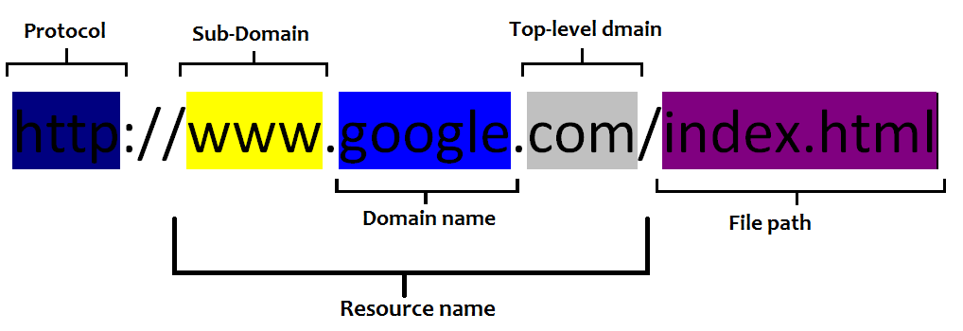
Web Page Adresses (URL) (Uniform Resource Locator )

Slide 10
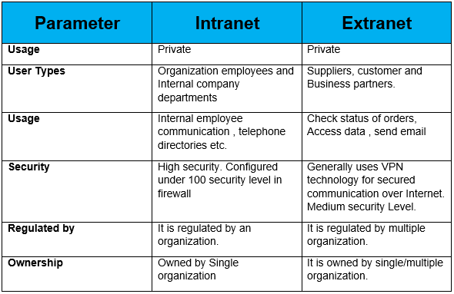
intranet vs extranet

Slide 11
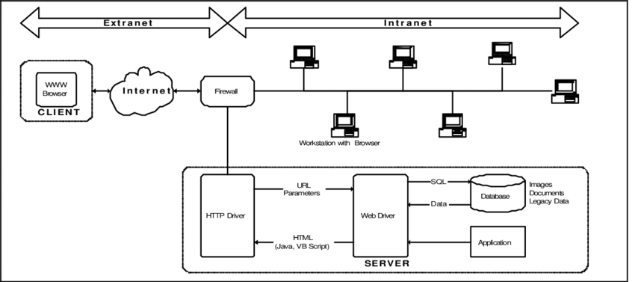
Implementation of intranet/extranet

Slide 12
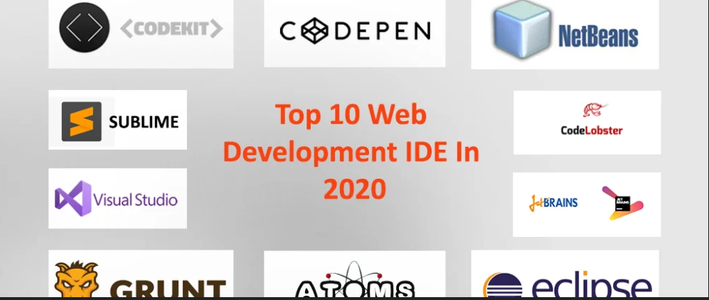

Presentation of development tools 1. ide : Integrated Development Environment
Visual Studio Code. ...
Atom by GitHub. ...
Sublime Text 3. ...
PyCharm. ...
IntelliJ IDEA. ...
PHPStorm. ...
Webstorm. ...
etc

Slide 13
Presentation of development tools 1. ide : Integrated Development Environment : Why VS code?
Support for multiple programming languages
Intelli-Sense: It can detect if any snippet of code is left incomplete.
Cross-Platform Support
Extensions and Support
Repository management
Web-Support
Hierarchy Structure
Improving Code
Terminal Support
Multiple projects containing multiple files/folders can be opened simultaneously
Git Support
Commenting facilities

Slide 14
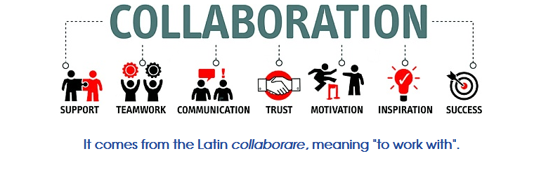
Collaborative working
People working jointly on an activity or project to achieve a common goal
Usually involves co-operation between several teams, departments and/or different organizations to achieve an agreed objective.

Slide 15
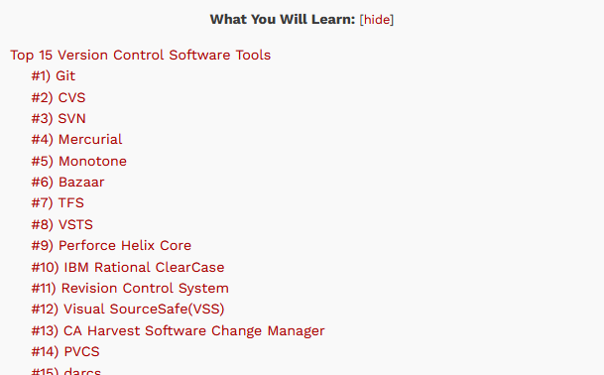
Collaborative working tools 1. version control tools
Version control systems are software tools that help software teams manage changes to source code over time. As development environments have accelerated, version control systems help software teams work faster and smarter.

Slide 16
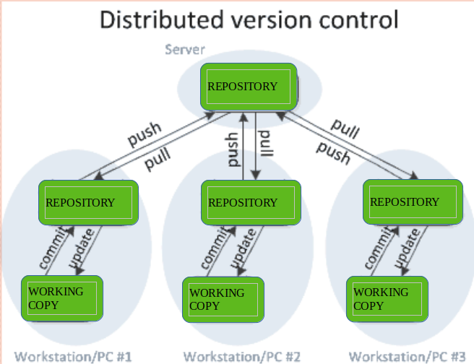

Collaborative working tools 1. version control tools : GitHub (www.github.com)

Slide 17
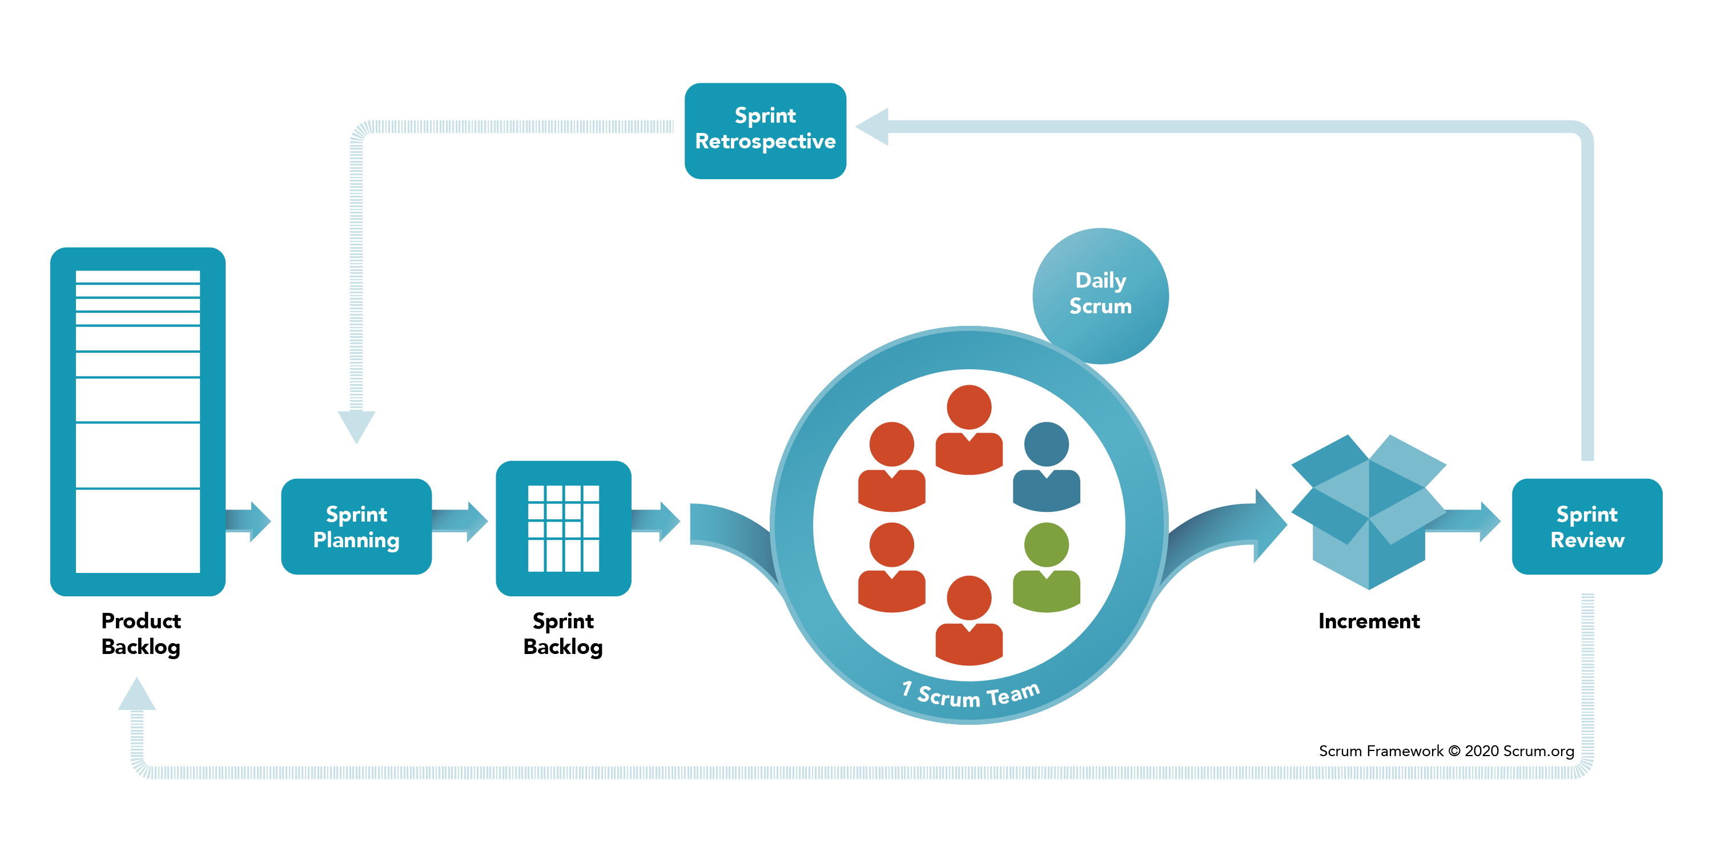
Collaborative working tools 1. scrum: find more on : https://www.atlassian.com/agile/scrum

Slide 18
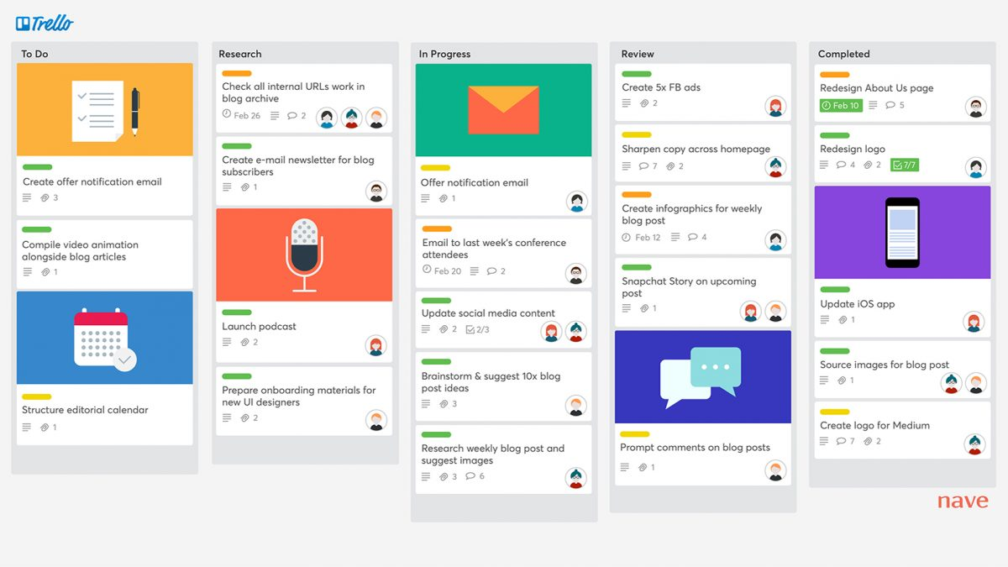
Collaborative working tools 2. scrum: Implementation With Trello (www.trello.com)

Slide 19
group works ideas for projects
Management of a football competition
Management of a school report cards and marks system
Online course platform
Online hiring platform (to hire people for services)

Slide 20
Review of the Day
Overview of previous knowledge
Internet VS World Wide Web
Internet, Intranet and Extranet
Implementation of an intranet
Presentation of development tools
Collaborative working
Presentation of group works

